Slide 1
MSP IoT Kit Overview
Geeky Goodies and Gadgets

Slide 2
Overview
What is IoT?
What’s
in the Kits?
Arduino & the ARDX
Spark Core
https://github.com/mspcontent/MSP-IoT-Kit-Overview

Slide 3
WHAT IS IoT?

Slide 4
What is the “internet of things”
Internet of things
Syllabification (Inter•net of things) noun
A proposed development of the Internet in which everyday objects have network connectivity, allowing them to send and receive data: “If one thing can prevent the Internet of things from transforming the way we live and work, it will be a breakdown in security.”
Source: Oxford Dictionary, yep, it’s really in the Oxford Dictionary. It got added mid 2013

Slide 5
CONNECTED “THINGS” vs people
2013 - Est. 10 Billion CONNECTED Devices
vs. Est. 7.14 Billion People World Population
Est. 50 Billion connected devices in 2020
More connected devices than connected people
2003
2008
2015
2020
Source: Cisco & Internet World Stats

Slide 6
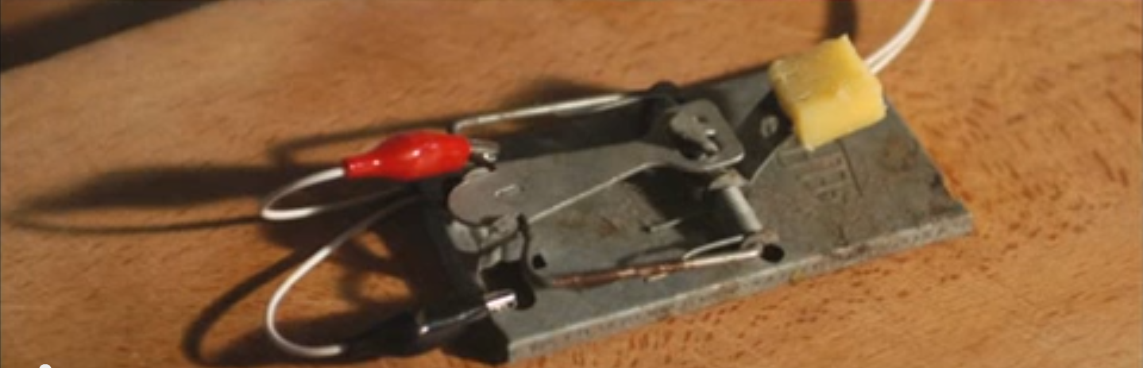
Building a better mousetrap
Source: “TEDx Warwick – Andy Stanford-Clark – Innovation Begins at Home”

Slide 7
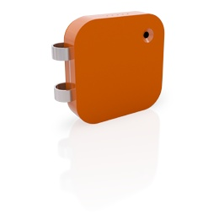

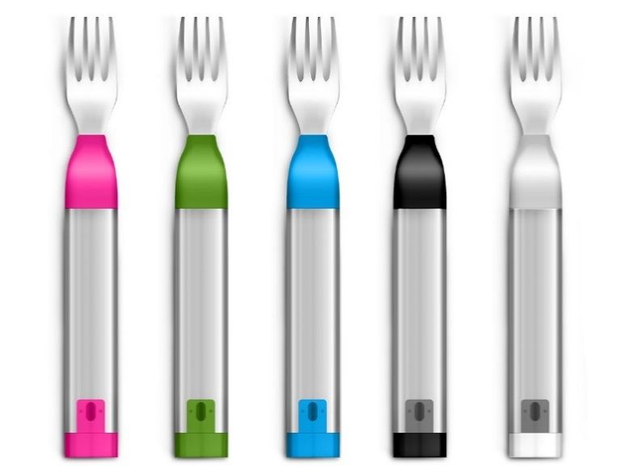
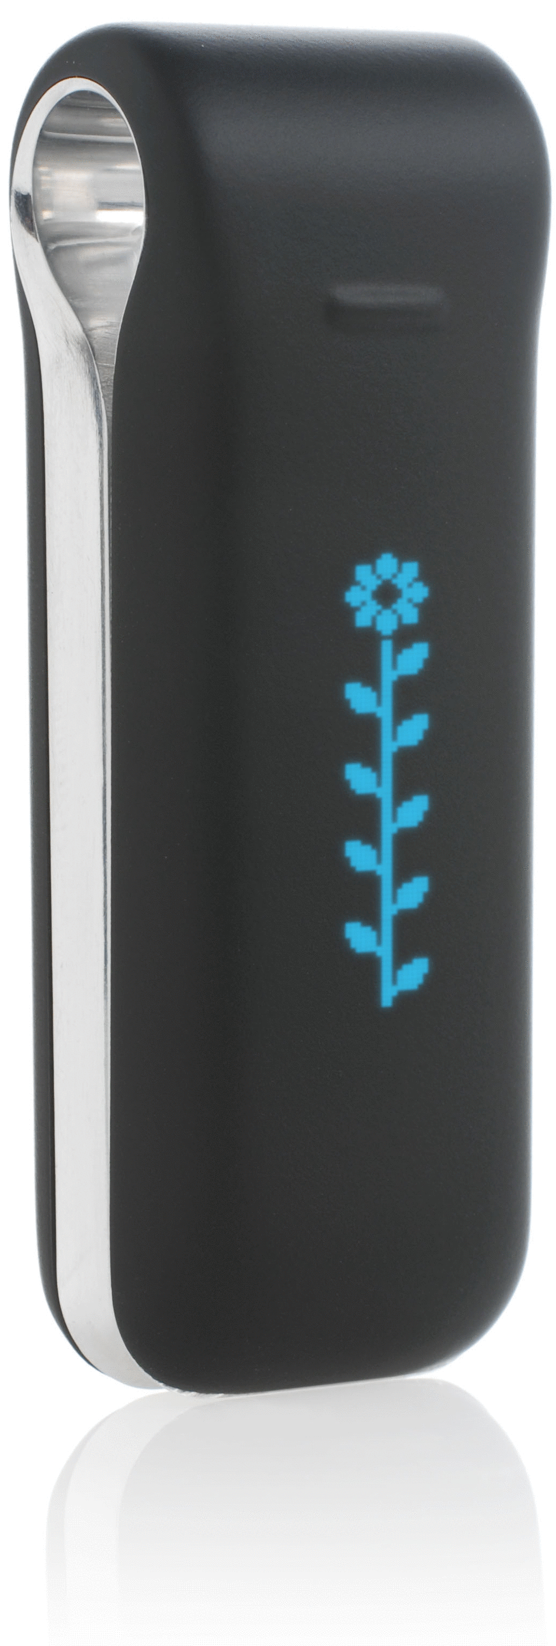


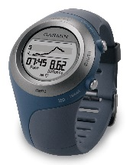

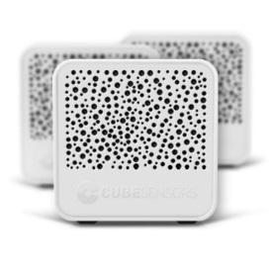
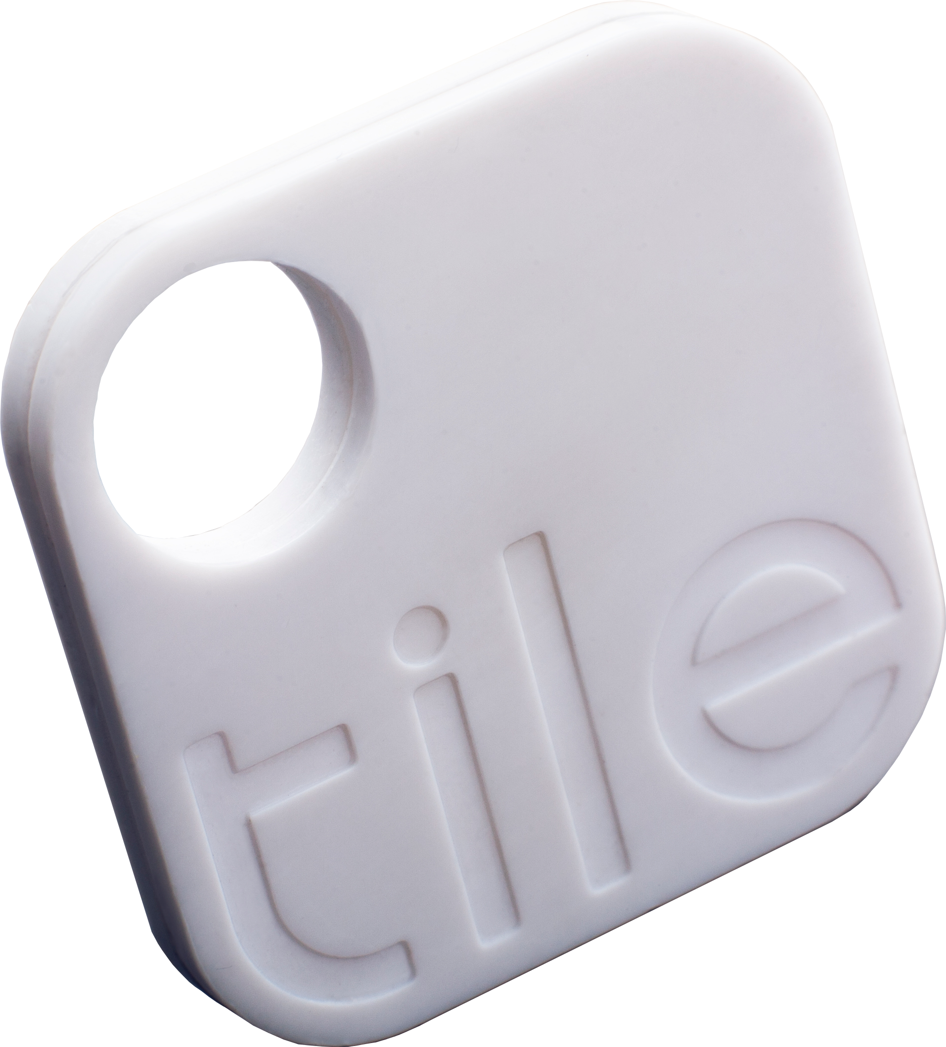


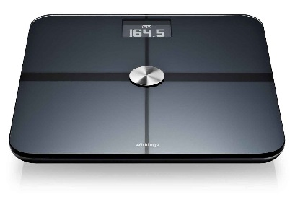

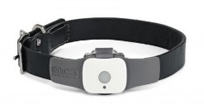

The Quantified self

Slide 8
What’s in the kits?

Slide 9
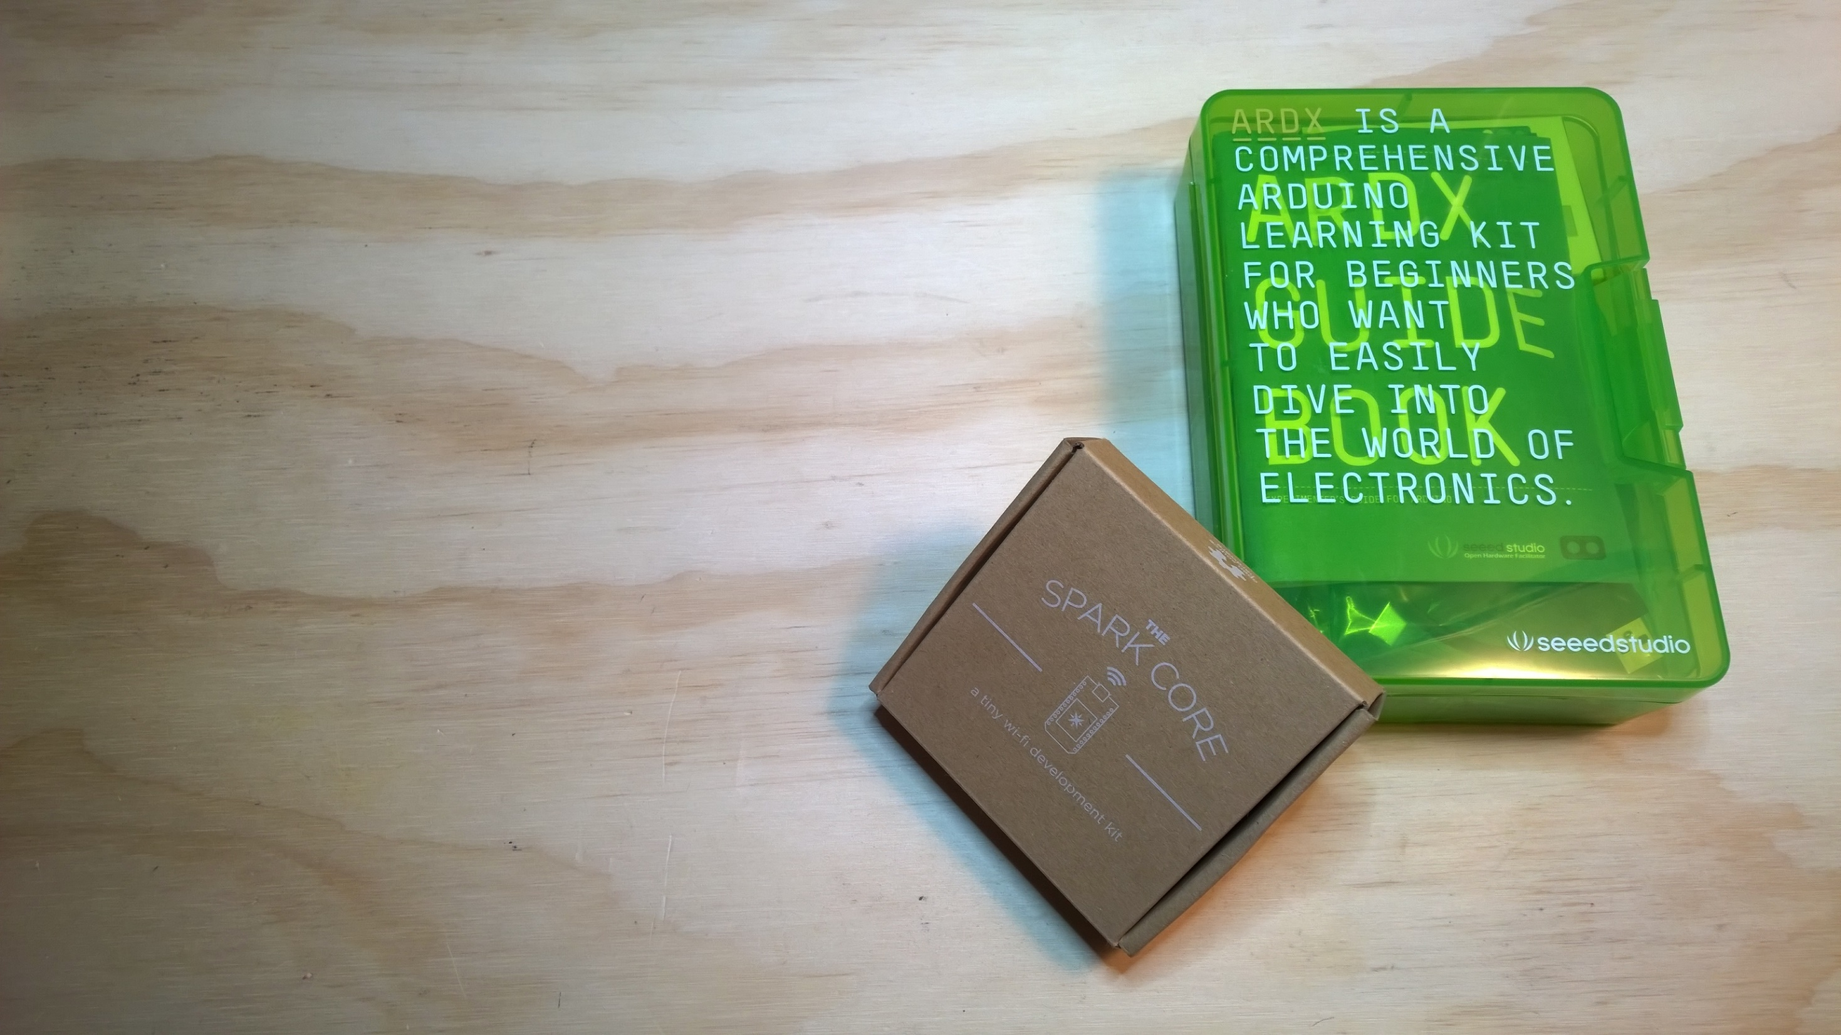
What’s in the kit?
Arduino Experimentation Kit (ARDX) with and Arduino Uno
Spark Core Dev Kit

Slide 10

Room to grow…

Slide 11
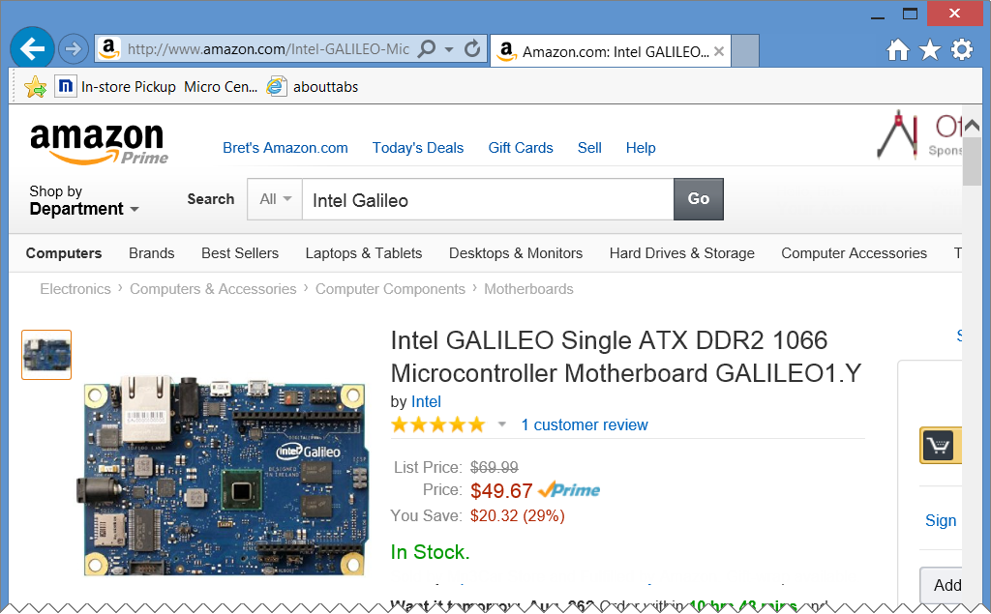
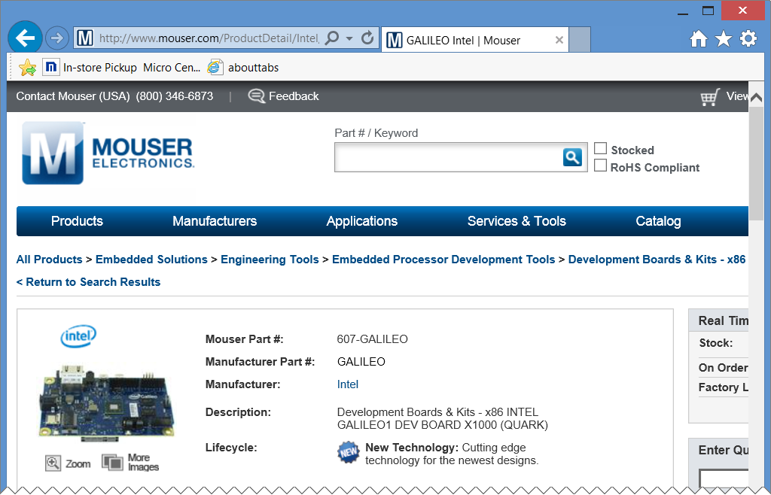
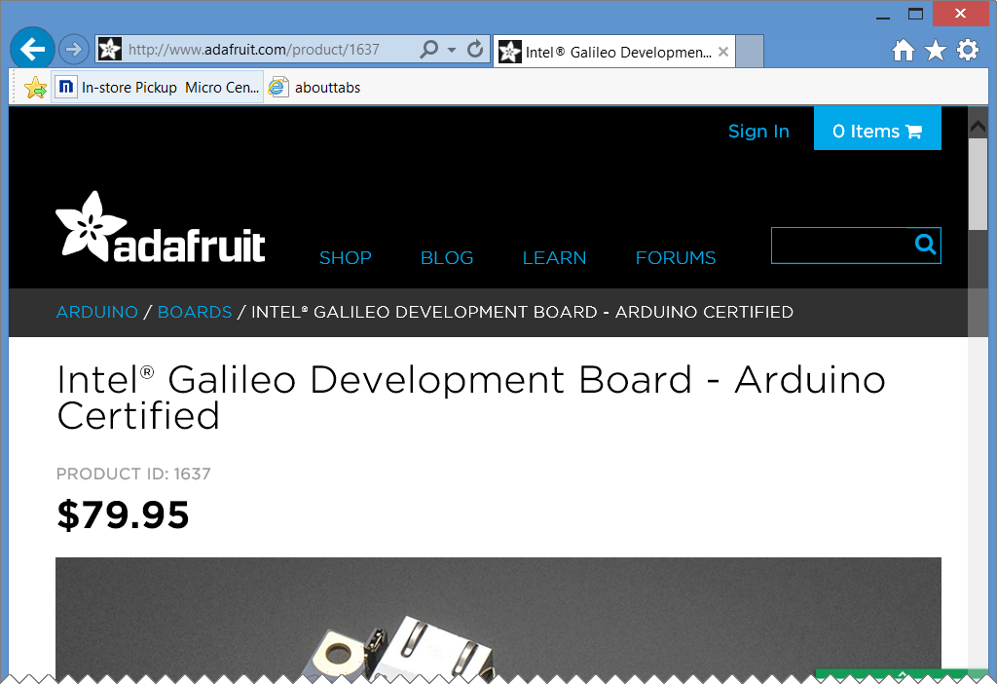
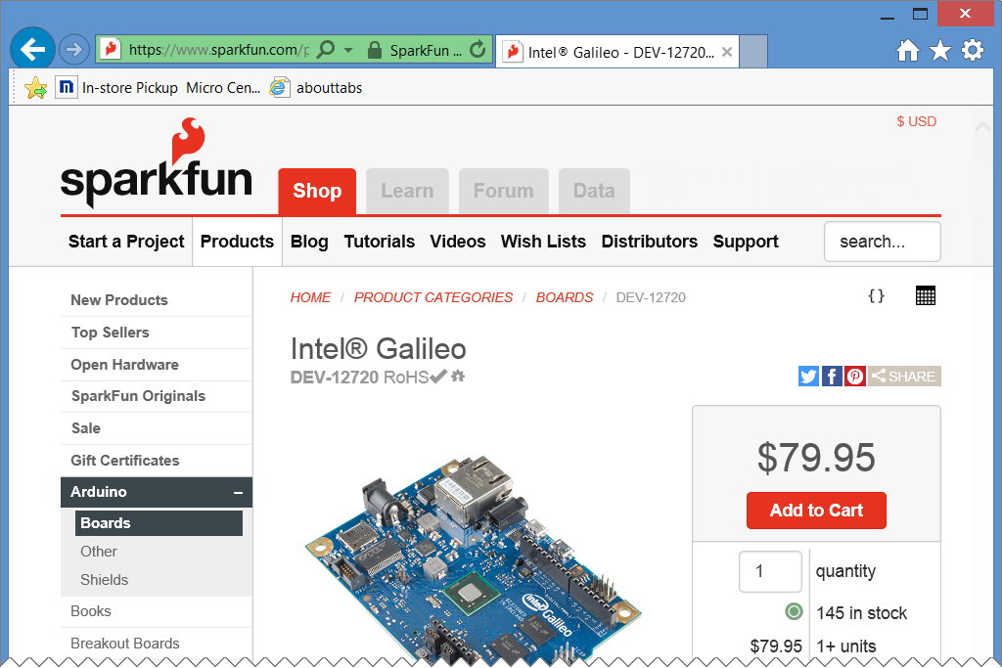
Other sources…

Slide 12
Arduino & THE ARDX

Slide 13
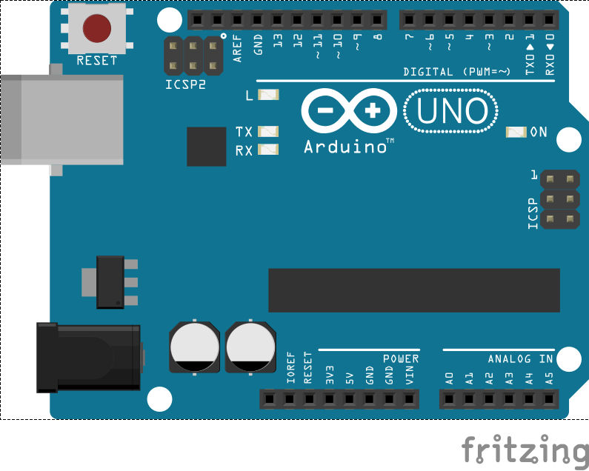
arduino
Arduino is possibly the most popular electronics prototyping platform ever. By connecting various sensors and actuators to the Arduino’s digital and analog IO pins, you can create devices that interact with the world in new and creative ways.
To write code for the Arduino, you can use the free Arduino IDE (grab it from arduino.cc)
Arduino programs, or “Sketches” are written in C or C++ and

Slide 14

ATMEL AVR microprocessors
8-Bit Processors (mostly)
Arduino is basically a “wrapper” around the chip providing convenient Access to the pins, power, reset, etc.

Slide 15
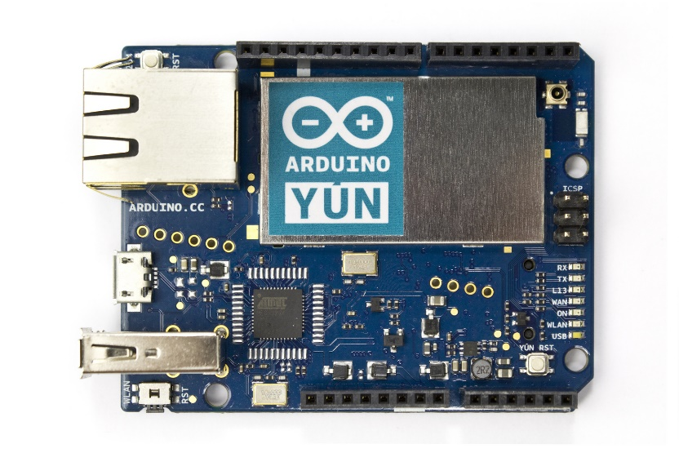
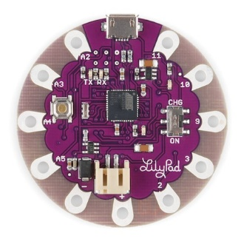
ARDUINO BOARDS

Slide 16
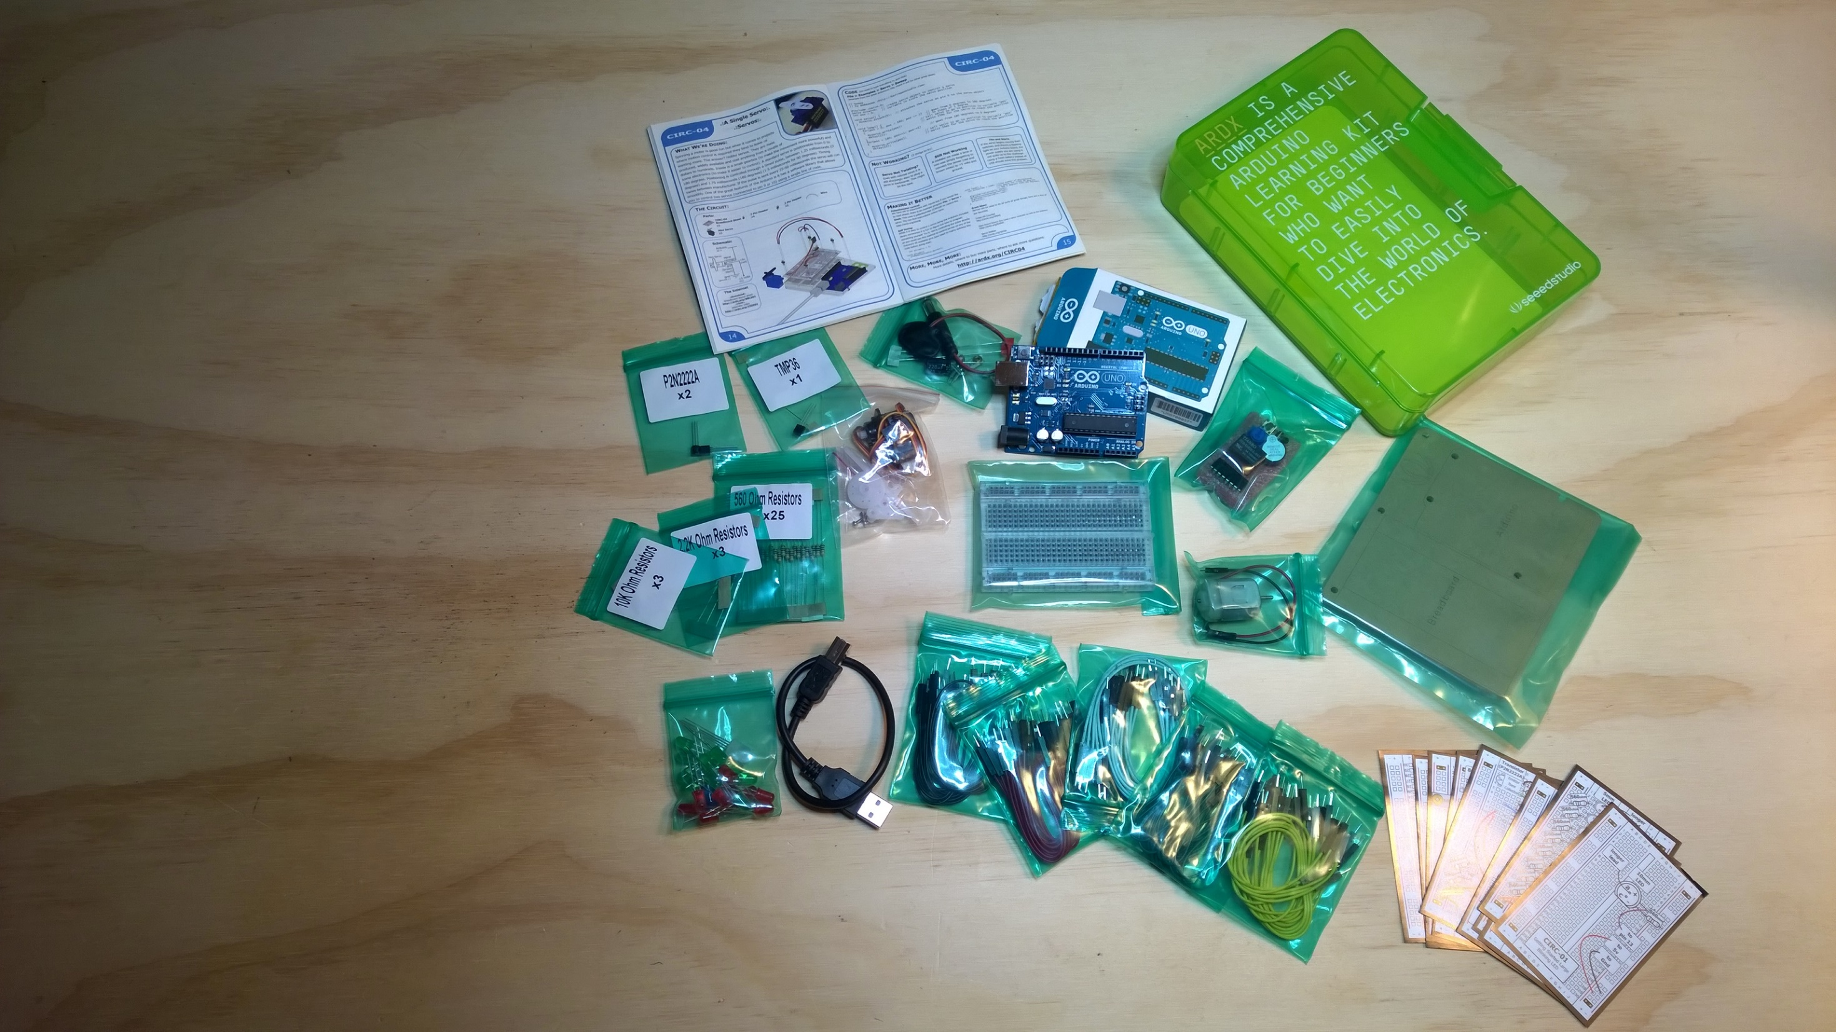
ARDX
Arduino Uno
Breadboard
LEDs
Resistors
Jumpers
Components
Motors
Circuit Diagrams
Guide Book
Mounting board

Slide 17
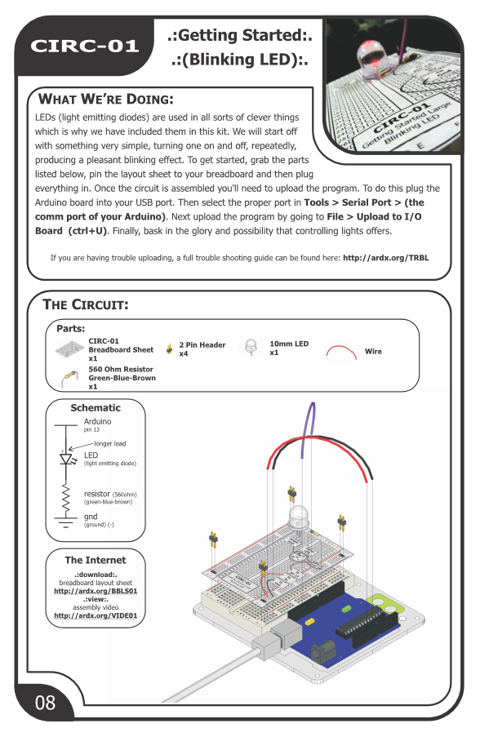
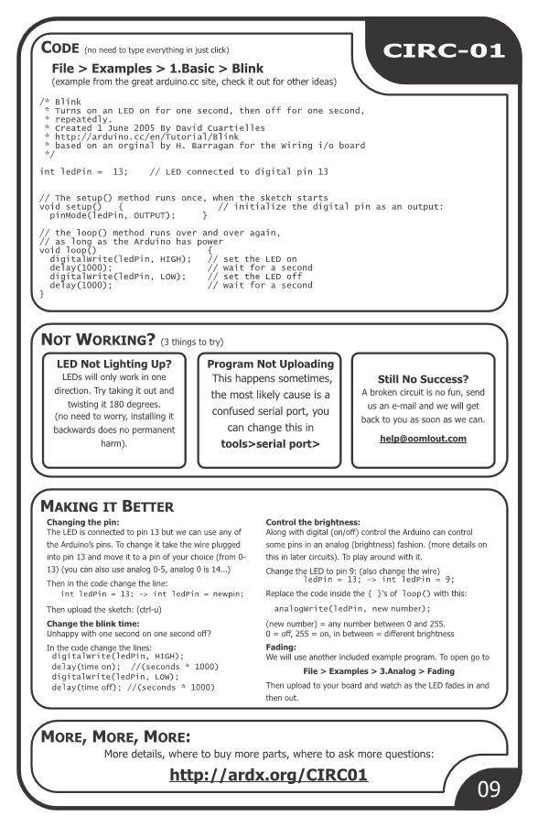

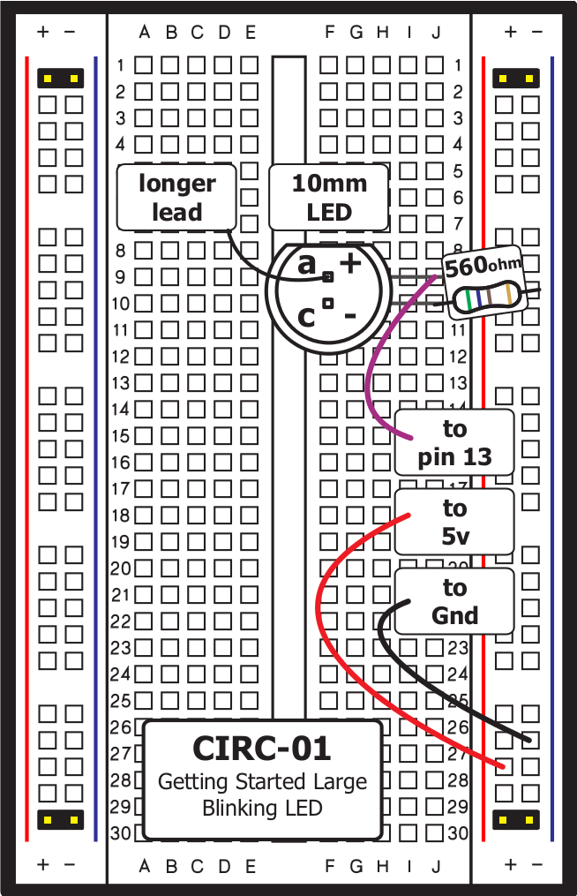
BLINK…
http://ardx.org/circ01

Slide 18
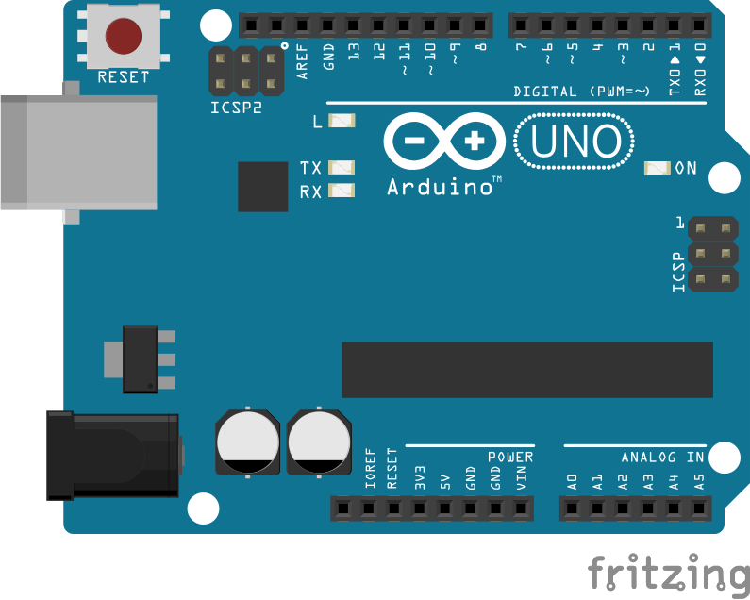
Arduino POWER
The Arduino can be powered either by the USB cable from the host PC or by an external DC power source (7V-12V Recommended Range). A 9V battery is a popular choice.
The Arduino also as 5V, 3.3V and 3 GND pins to supply voltages to your project components.

Slide 19

Arduino Digital Pins
Pins 0-13 Are Digital Pins
pinMode(pin,INPUT) sets a pin as an input
pinMode(pin,OUTPUT) sets the pin as output
digitalWrite(pin,LOW) sets the pin to 0v
digitalWrite(pin,HIGH) sets the pin to +5v
digitalRead(pin) reads the pin state
Analog Pins A0-A5 can also be used as digital pins if they aren’t needed for analog use.

Slide 20

LEDs
Anode (+)
Cathode (-)
Flat Edge
Small Post
Big Post
Long Leg
Short Leg
Vcc (+)
GND

Slide 21
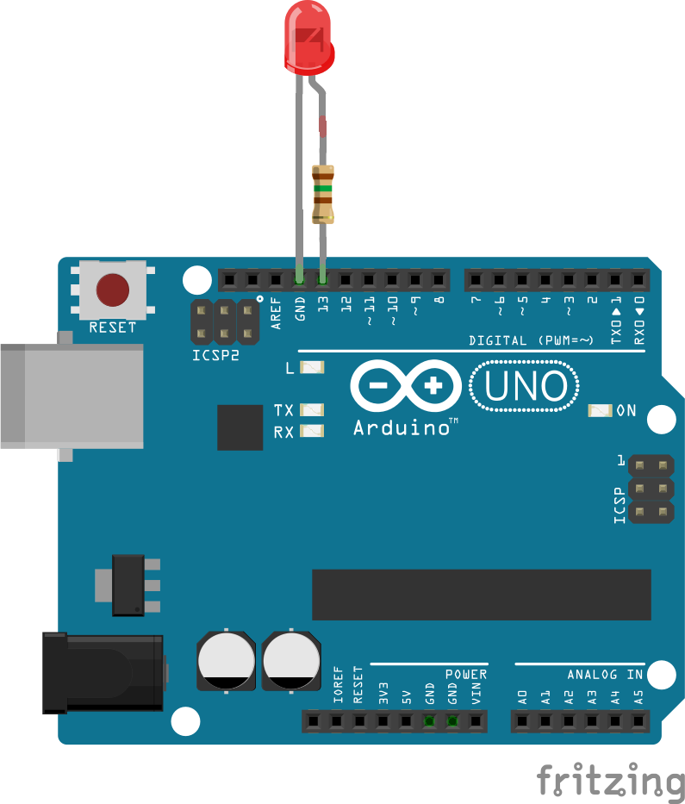
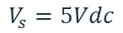
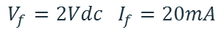
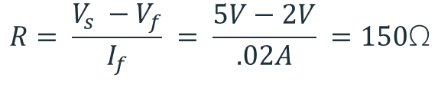
Current limiting resistors
Providing more current than an LED is rated for can destroy the LED. To prevent that, you should use a “Current Limiting” resistor.
To calculate the value of the resistor you need to know the supply voltage, and the LEDs rated Forward Voltage (the voltage drop across the LED) and Forward Current (the maximum current the LED can handle)
$$V_{f}=2Vdc I_{f}=20mA$$
$$Resistor Value (R)= \frac{Supply Voltage \left(V_{s}\right)−LED Forward Voltage (V_{f}) }{LED Forward Current (I_{f})}$$
$$V_{s}=5Vdc$$
$$R= \frac{V_{s} −V_{f}}{I_{f}} = \frac{5V−2V}{.02A} =150\text{Ω}$$
Having said that, you’ll likely find that for most quick experiments and demos you can skip using a current limiting resistor and just power the LED directly. USUALLY the LED will survive just fine, but sometimes…..
http://ledcalculator.net/

Slide 22
Arduino and Blink

Slide 23
Spark Core

Slide 24
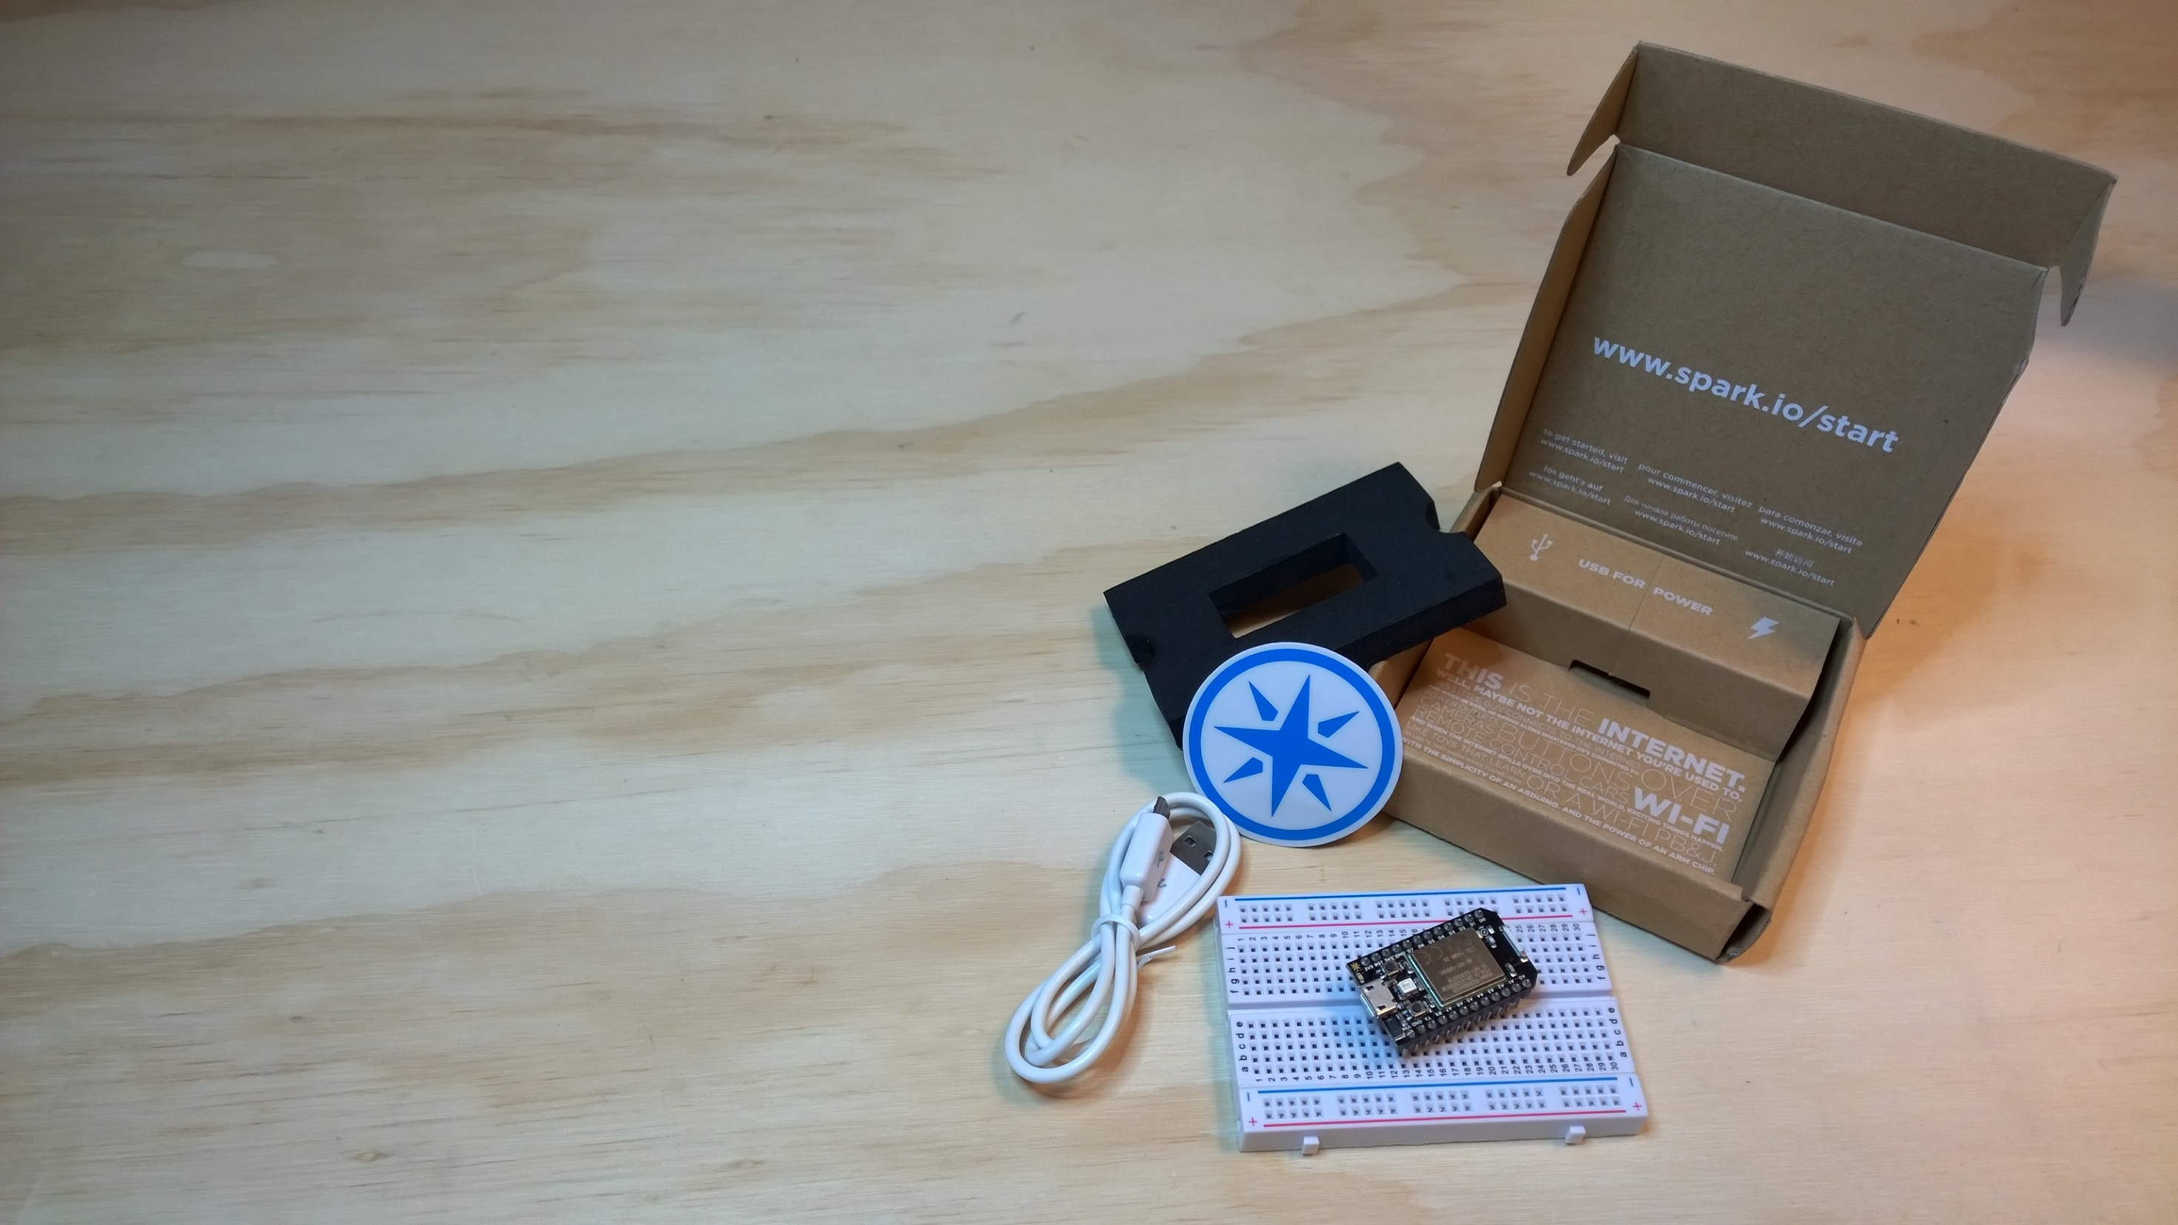
Spark Core
Arduino-ish
Uses a similar API
Digital / Analog IO
Browser based IDE (http://spark.io/build)

Slide 25
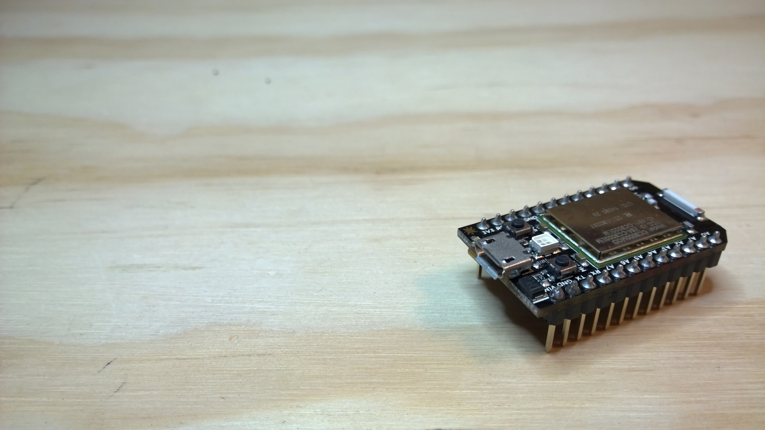
Spark Core
Built-in WiFi
Free “Cloud Backend” for exposing your Spark Core to apps
Makes it easy to create IoT devices

Slide 26
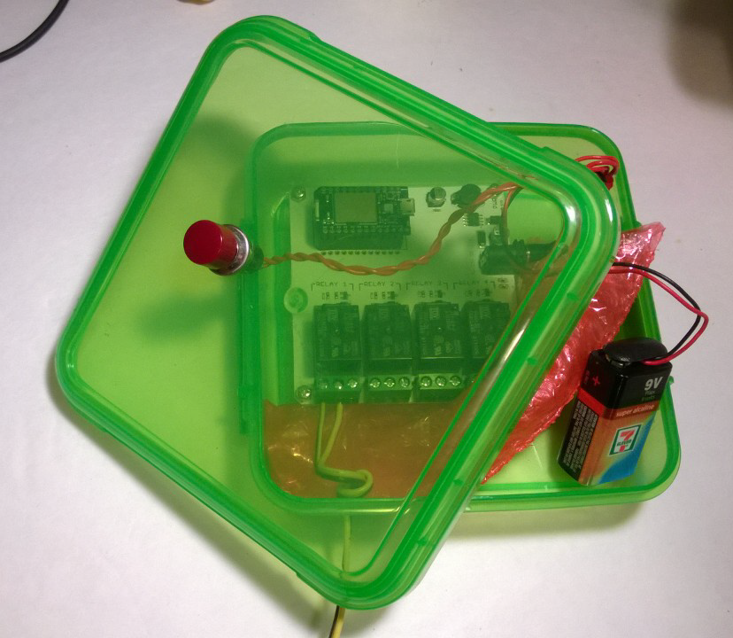
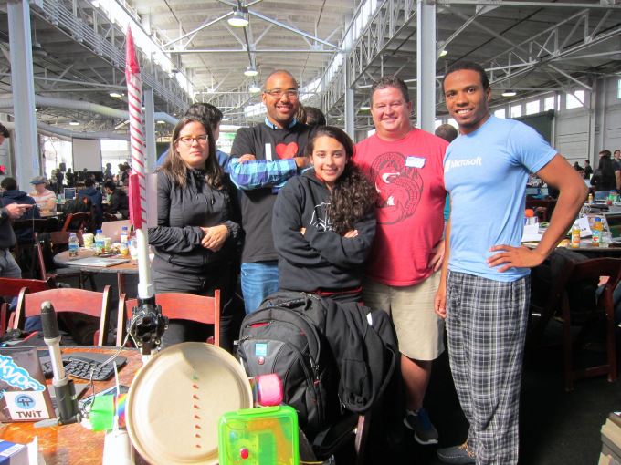
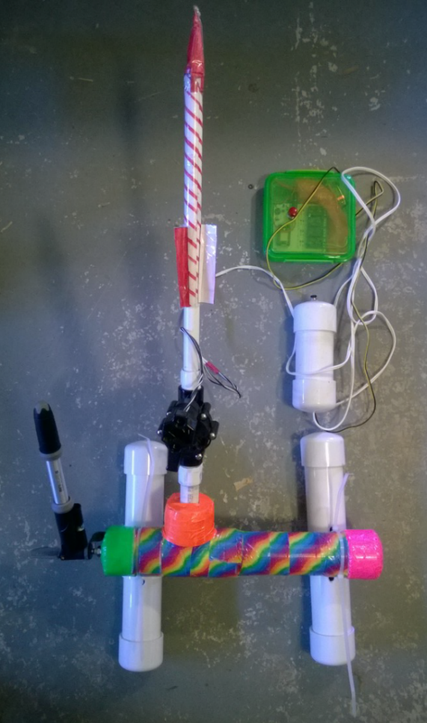
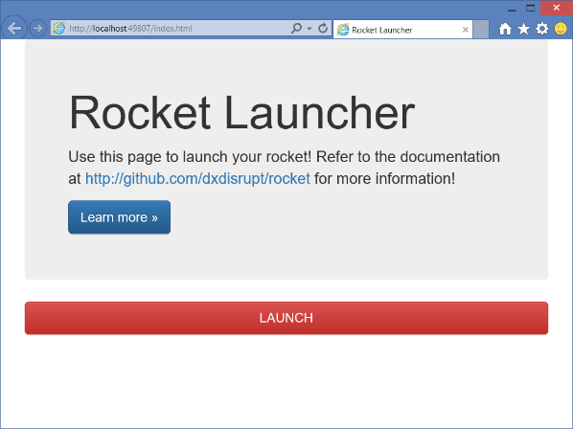

Internet enabled compressed air rocket launcher…
https://github.com/dxdisrupt/rocket

Slide 27
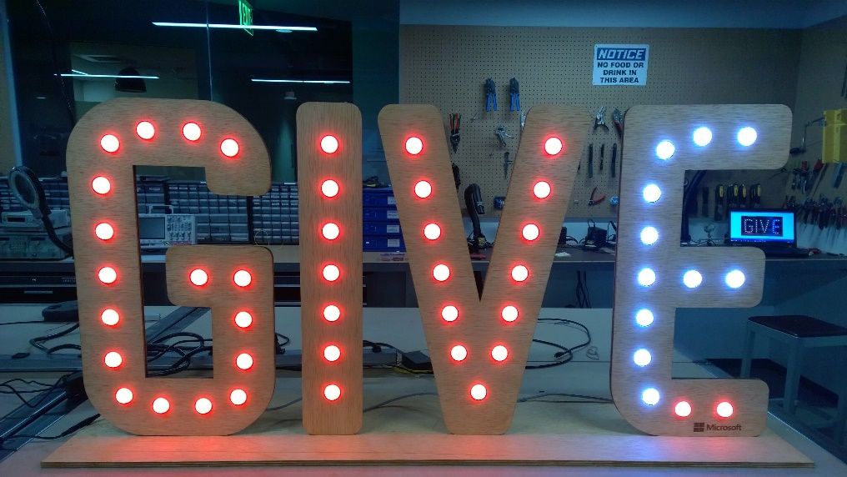
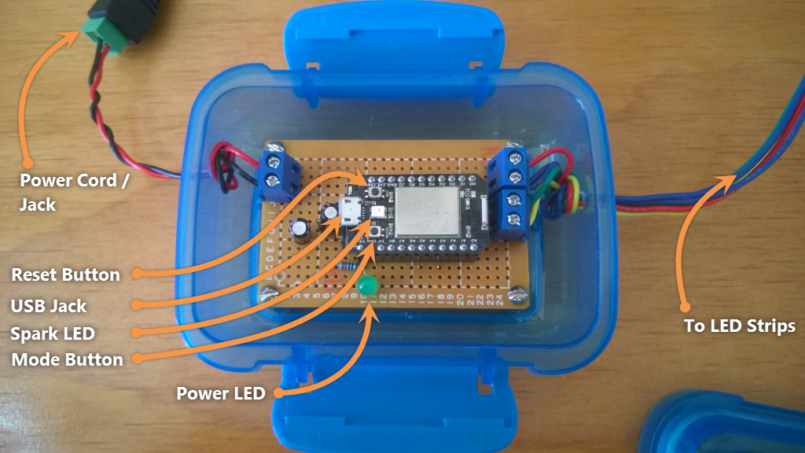
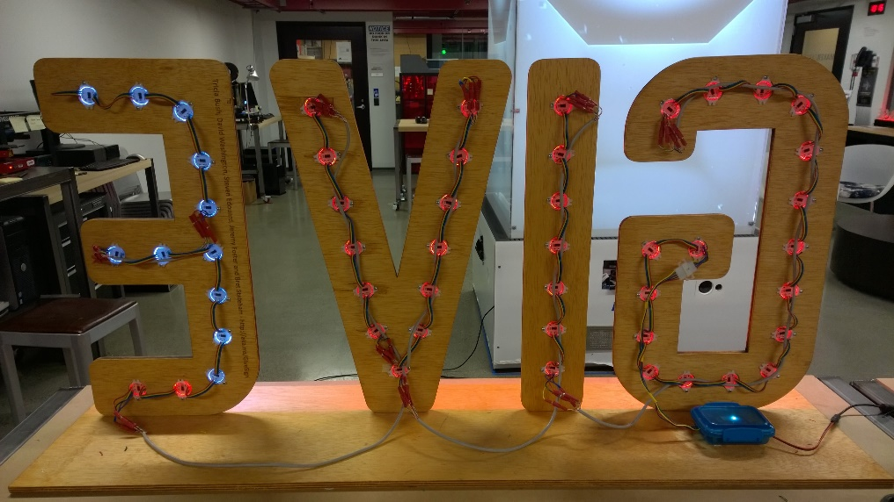
“GIVE” DONATIONS TRACKER…
https://github.com/BretStateham/GiveSign

Slide 28
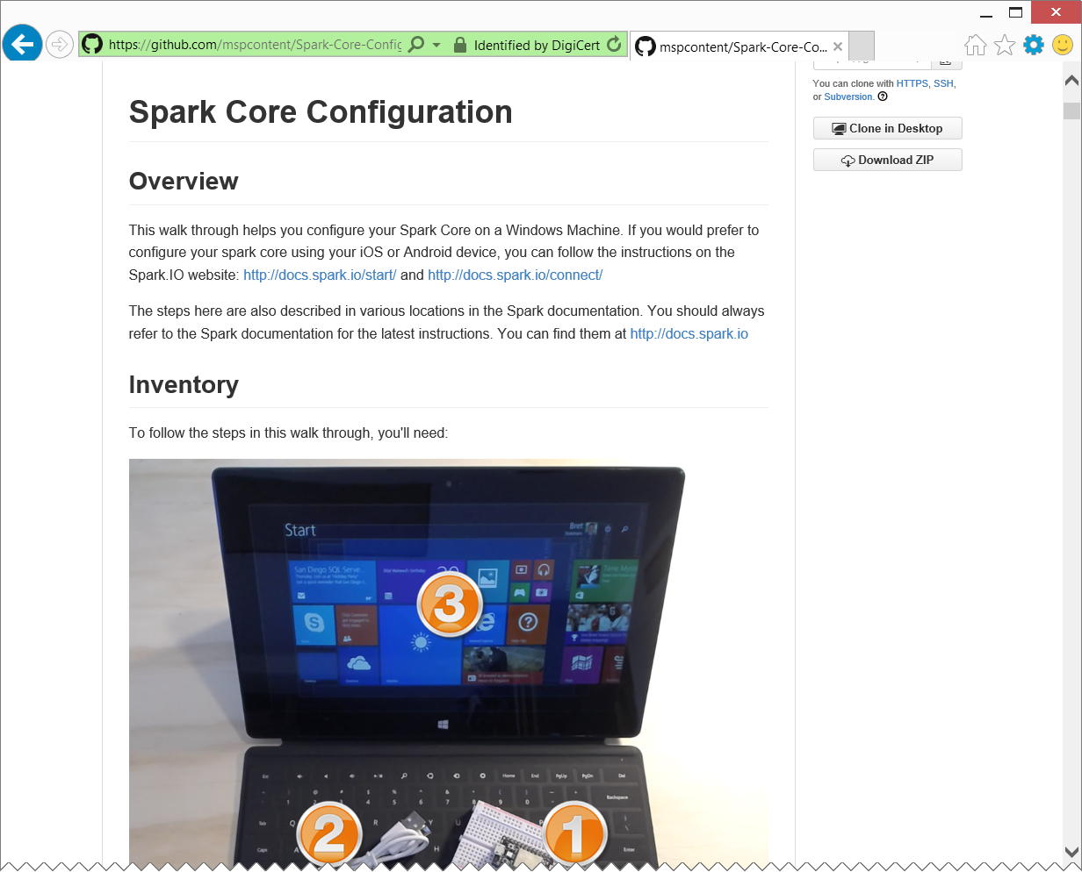
Configuring your spark core…
https://github.com/mspcontent/Spark-Core-Configuration

Slide 29
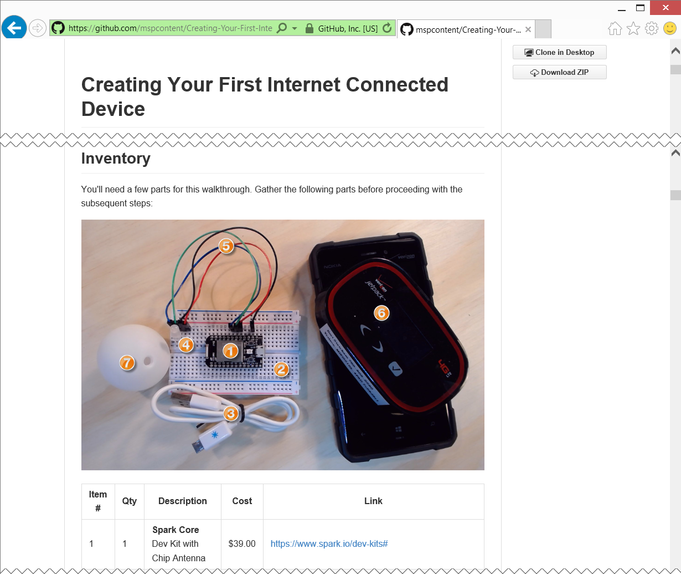
Creating and iot device…
https://github.com/mspcontent/Creating-Your-First-Internet-Connected-Device

Slide 30
Azure – Putting the “I” in IoT
Microsoft Azure Web Sites make it very simple to create web applications and APIs in the cloud.
Fingers crossed, students will gain some level of access to Azure Web Sites in the near future
Virtual Machines Windows & Linux
Mobile Services
For iOS, Android, and more
SQL Database MongoDB, MySQL…
Storage Services

Slide 31
RGB LED Internet Lamp

Slide 32
Cool, what now?
Go build something cool with your Arduino’s and Spark Cores
If you have questions, reach out to the community
Don’t forget to leverage resources at your school
If you build something cool, write it up and contribute it to the github content.
Ask Bret.Stateham@Microsoft.com for instructions and access
If you find that you are pushing the limits of what you can do with what you have, let Matt Secord (v-maseco@microsoft.com) know
https://github.com/mspcontent/MSP-IoT-Kit-Overview

Slide 33
IoT Logo

Slide 34
arduino

Slide 35
GALILEO BOARD

Slide 36
LEDs

Slide 37
Resistors
220Ω
1st Digit
2nd Digit
Multiplier
Tolerance
Color | Name | 1st Digit | 2nd Digit | Multiplier | Tolerance
 | Black | 0 | 0 | X1
 | Brown | 1 | 1 | X10 | 1%
 | Red | 2 | 2 | X100
 | Orange | 3 | 3 | X1,000
 | Yellow | 4 | 4 | X10,000
 | Green | 5 | 5 | X100,000
 | Blue | 6 | 6 | X1,000,000
 | Violet | 7 | 7
 | Grey | 8 | 8
 | White | 9 | 9
 | Gold |  |  | X0.1 | 5%
 | Silver |  |  | X0.01 | 10%
330Ω
10KΩ

Slide 38
cables

Slide 41
Micro SD Cards
Font: Segoe UI Semibold

